Slide 1



Dr. Babasaheb Ambedkar Marathwada University, Aurangabad
DEPARTMENT OF STATISTICS
PROJECT TITLE
A STATISTICAL ANALYSIS OF EMPLOYEE’S ATTRITION AND RETENSION
UNDER THE GUIDENCE OF
DR. MRS. CHHAYA SONAR MADAM
PRESENT BY
GAYATRI BALLAL
MAYURESH GORE
SAPNA JADHAV

Slide 2

CONTENTS
INTRODUCTION
OBJECTIVES
REVIEW OF LITERATURE
DATA COLLECTION
STATISTICAL TOOLS
RESEARCH METHDOLOGY
EXPLORATORY ANALYSIS
STATISTICAL ANALYSIS
CONCLUSION
REFERENCES

Slide 3

INTRODUCTION
Attrition is said to be the gradual reduction in the number of employees through retirement, resignation or death. It can also be said as Employee Turnover or Employee Defection.
Attrition means that number of employees leaves an organization from a specific group over a period of time.
Retention means employees that stay with the organization during that time frame.
The present research work would be helpful for most companies to know about their employee's satisfaction levels and get some useful information that would aid in controlling the attrition rate.
REASONS BEHIND EMPLOYEES ATTRITION
Low salaries.
Limited bonus or incentive structures.
Inadequate vacation time.
Lack of health insurance or other benefits.
Lack of performance recognition or rewards.

Slide 4
Need of the study
It is important to find the reason for the dissatisfaction of the employees due to which they change the jobs.
Once the levels of employee’s attitude are identified, it would be possible for the management to take necessary action to reduce attrition level.
Since they are considered as backbone of the company their progression will lead to the success of the company for the long run.
Limitation
Due to lack of time we have taken secondary dataset.

Slide 5
OBJECTIVES
1. To find the reason of attrition among employees.
2. To determine highly contributing factors which affects employee’s attrition.
3. To determine impact of demographic factors on attrition.
4.To find the association of various parameters with attrition.
5. To find the best fitted classifier for attrition data.

Slide 6
REVIEW OF LITERATURE
1.Title: A study of employees attrition among executives at BGR energy systems ltd, Chennai (IRJC)
Authors: DR. R. AKILA
Published year: 2012
Publication: IRJC
Volume no.: 9
The data collected was analysed using ANOVA, Rank correlation, Weighted Average Method, Regression, Chi square and Percentage Analysis. The analysis on the collected data revealed that the Employees have given highest weighting to comfortableness in working hours and are not satisfied with annual increments provided.
2.Title: An investigation into the effect of knowledge management on employee retention in the telecom sector.
Authors: Nurul Mohammad Zayed, Friday Ogbu Edeh, Khann Mohammad Anwarul Islam, Vitalii Nitsenko, Tetiana dubovyk, hanna doroshuk.
Published year: 2022
Publication:MDPI
Volume no.:-
In this paper data is collected from Nigeria related to knowledge and management of employee’s attrition. The analysis showed that there is a significant and positive impact of knowledge management processes on innovation in Jordanian consulting firms while the social network approach has a significant negative impact with innovation.
Employees Attrition Prediction Using Deep Neural Networks
Explaining and predicting employee’s attrition: a machine learning approach
From big data to deep support people analytics for employee attrition prediction
Predictive employees attrition using machine learning approches

Slide 7
3.Title-Explaining and predicting employees attrition : a machine learning approach
Author : Praphula Kumar Jain, Madhavi Jain, Rajendra Pamula
Published year: 2020
Journal name: Springer
Volume no.: -
In this paper data mining techniques are use for prediction and classification.
accuracy of random forest is 99% and it is greater than decision tree and SVM so, random forest is significantly better.
4. Title: From big data to deep support people analytics for employee attrition prediction
Author: Nesrine Ben, Yahia, Jihan Hlel, Ricardo colomo-palacios(senior member )
Published year: 2021
Journal name: IEEE
Volume no.: 9
In this paper survey is conduct in different countries like Tunisia, Norway, France, United States, China, Italy, Pakistan, India, England and Germany. Survey is conduct through an online Questionnaire .
Classifiers like XGB, Random Forest, Decision Tree, Logistic Regression, SVM ,VC are used for classification. From the analysis they found that Voter classifier (VC) performs better than other models.

Slide 8
5. Title: Employees Attrition Prediction Using Deep Neural Networks (MDPI)
Authors: Salah Al Darraji ,Dhafer G. Honi , Francesca Fallucchi, Ayad I. Abdulsada, Romeo Giuliano, Husam A. Abdulmalik
Published year: 2021
Journal name: MDPI
Volume no.: -
In this paper, decision trees, random forest, naïve bayes, logistic regression, SVM, DNN are used for classification. They used deep learning model to classify employees attrition. From the analysis the found that accuracy of DNN is greater than all other classifiers. So DNN performs better than all other models.
6. Employee attrition using predictive techniques (Springer)
Authors: Devesh Kumar Srivatsava , Priyanka Nair
Published year: 2018
Journal name: Springer
Volume no.: 1
In this paper 10000 of employee data have been taken into account. Then various classifiers are use for prediction and classification. The artificial neural network gave 40% accuracy for the data.

Slide 9
7. Title: Predicting employees attrition using machine learning approaches (MDPI)
Authors: Ali Raza, Kashif Munir, Mubarak Almutairi, faizan Younas, Mian Muhammad Sadiq Fareed.
Published year: 2022
Journal name: MDPI
Volume no.: -
In this paper, classifiers Such as SVM, Logistic Regression, Decision Tree, Extra Tree Classifier are use for predicting employees attrition. From analysis they found that accuracy of ETC i.e., 93% is greater than all other classifiers so, ETC performs better than all other models.

Slide 10
DATA COLLECTION
Our project is based on secondary data.
This IBM Employees dataset is taken from Kaggle .
The data set contains 1470 records and 32 features.
There are 32 features in our data namely age, attrition, department, daily rate, distance from home, education, education field, environment satisfaction, employee count, employee number, gender, hourly rate, job involvement, job role , job satisfaction, marital status, monthly income, monthly rate, number of companies worked, overtime, percent salary hike, performance rating, relationship satisfaction, Stock Option Level, Total Working Years, Training Times Last Year, Work Life Balance, Years At Company, Years In Current Role, years since last promotion, Years With Current Manager.

Slide 11
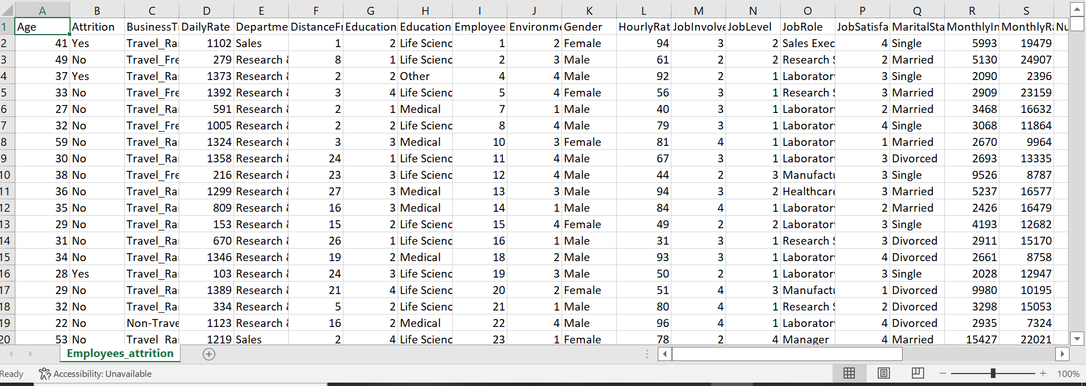
SAMPLE DATA SHEET

Slide 12
STATISTICAL TOOLS
Machine learning
Classification
Chi square test
Correlation
Data Visualization using POWER BI.
MS Excel
MS Word
R
Python

Slide 13
Data Pre-processing and modelling
Firstly check any missing values or duplicate values in the data if any then replace it by mean, mode.
A dataset with skewed proportions is called imbalanced dataset.
In that a class that make up a large proportion of data are called majority class.
Those that make up smaller proportion are called minor class.
To balance the class proportion there are two different methods Over sampling and Under sampling.
Over sampling
Over sampling means creating a bootstrap sample from minor class with class length around length of majority class.
Under sampling
Under sampling reduces the class length of majority class up to the length of minority class. In this procedure we collect a random sample of size around the class length of minor class from major class.
Test dataset and train dataset
Separating data into train and test datasets is an important part of evaluating data.
By this separation of total dataset into two datasets we can minimize effects of data inconsistency and better understand the characteristics of the model.

Slide 14
RESEARCH METHODOLOGY
LOGISTIC REGRESSION
Logistic Regression is a “Supervised machine learning” algorithm that can be used to model the probability of a certain class or event.
It is used when the data is linearly separable and the outcome is binary or dichotomous in nature.
That means Logistic regression is usually used for Binary classification problems. Binary Classification refers to predicting the output variable that is discrete in two classes.
A few examples of Binary classification are Yes/No, Pass/Fail, Win/Lose, etc
Assumptions of Logistic Regression
Dependent variable is binary-If this is not true, then logistic regression outputs do not apply.
Linearity between logit and independent variables
No multicollinearity-Multicollinearity distorts tests of statistical significance on regression coefficients. Large sample size-This is more of a rule of thumb.
A nice to have here is that your data has a balanced number of classes
Terms to know: Odds Ratio = 𝜋/ (1−𝜋)
The odds ratio is defined as the probability of success as compared to the probability of failure.

Slide 15
CONFUSION MATRIX
A Confusion matrix is an N x N matrix used for evaluating the performance of a classification model, where N is the number of target classes.
The matrix compares the actual target values with those predicted by the machine learning model.
True Positive (TP)
• The actual value was positive and the model predicted a positive value
True Negative (TN)
• The actual value was negative and the model predicted a negative value
False Positive (FP) – Type 1 error
• The actual value was negative but the model predicted a positive value
False Negative (FN) – Type 2 error
• The actual value was positive but the model predicted a negative value

Slide 16
Different Metrices use on Confusion Matrix
❖ Accuracy: It means the total number of two correct predictions divided by the total number of data set.
Accuracy = 𝑇𝑝+𝑇𝑁 /𝑇𝑃+𝐹𝑃+𝑇𝑁+𝐹𝑁
❖ Sensitivity: It tells us how many of the correctly predicted cases actually turned out to be positive
Sensitivity = 𝑇𝑃 /𝑇𝑃+𝐹𝑁
❖ Specificity: It tells how many of the actual positive cases we were able to predict correctly with our model
Specificity = 𝑇𝑁 /𝑇𝑁+𝐹𝑃
❖ F1-Score: F1-score is a harmonic mean of Precision and Recall, and so it gives a combined idea about these two metrics. It is maximum when Precision is equal to Recall. But there is a catch here. The interpretability of the F1-score is poor.
F1-Score = 2∗(𝑅𝑒𝑐𝑎𝑙𝑙∗𝑃𝑟𝑒𝑐𝑖𝑠𝑖𝑜𝑛) (𝑅𝑒𝑐𝑎𝑙𝑙+𝑃𝑟𝑒𝑐𝑖𝑠𝑖𝑜𝑛 )

Slide 17
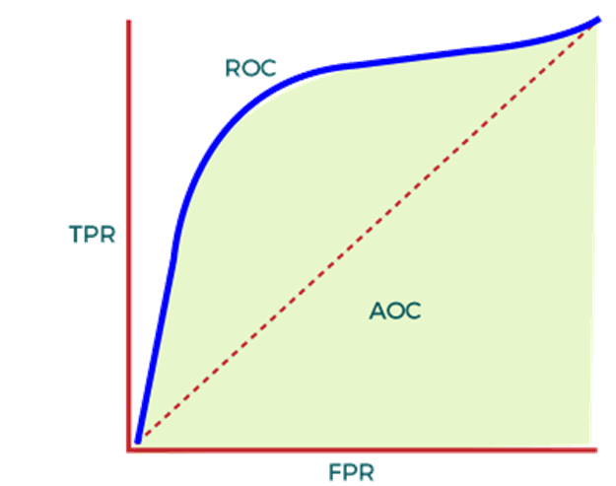
ROC CURVE
An ROC curve (receiver operating characteristic curve) is a graph showing the performance of a classification model at all classification thresholds. This curve plots two parameters:
True Positive Rate
False Positive Rate
True Positive Rate (TPR) is a synonym for recall and is therefore defined as follows:
TPR= TP/(TP+FN)
False Positive Rate (FPR) is defined as follows:
FPR=FP/(FP+TN)
AUC:
AUC is known for Area Under the ROC curve.
AUC calculates the two-dimensional area under the entire ROC curve ranging from (0,0) to (1,1).
HEATMAP
A heat map is a 2-dimensional data visualization technique that represents the magnitude of individual values within a dataset as a color.
The variation in color may be by hue or intensity.

Slide 18
2. RANDOM FOREST
Random Forest is a popular machine learning algorithm that belongs to the supervised learning technique.
It can be used for both Classification and Regression problems in Machine Learning.
random forest is a classifier that contains a number of decision trees on various subsets of the given datasets and takes the average to improve the predictive accuracy of that dataset.
3.SUPPORT VECTOR MACHINE
Support vector machines (SVMs) are a set of supervised learning methods used for classification, regression and outliers detection.
Important concepts in SVM −
Support Vectors
Datapoints that are closest to the hyperplane is called support vectors. Separating line will be defined with the help of these data points.
Hyperplane − As we can see in the above diagram, it is a decision plane or space which is divided between a set of objects having different classes
Margin − It may be defined as the gap between two lines on the closet data points of different classes.

Slide 19
5. K NEAREST NEIGHBOUR
KNN is one of the most simple and traditional non-parametric techniques to classify samples.
Given an input vector, KNN calculates the approximate distances between the vectors and then assign the points which are not yet labelled to the class of its K-nearest neighbours.
The lazy algorithm means it does not need any training data points for model generation.
All training data used in the testing phase.
This makes training faster and the testing phase slower and costlier.

Slide 20
6.ARTIFICIAL NEURAL NETWORK
Artificial Neural Networks contain artificial neurons which are called units.
These units are arranged in a series of layers that together constitute the whole Artificial Neural Network in a system.
Artificial Neural Network has an input layer, an output layer as well as hidden layers.
The input layer receives data from the outside world which the neural network needs to analyse or learn about.
Then this data passes through one or multiple hidden layers that transform the input into data that is valuable for the output layer.
Finally, the output layer provides an output in the form of a response of the Artificial Neural Networks to input data provided.

Slide 21

Pearson’s Chi square test
Where,
Χ² is the chi-square test statistic
Σ is the summation operator (it means “take the sum of”)
O is the observed frequency
E is the expected frequency
We use this test for checking independency of attributes.

Slide 22
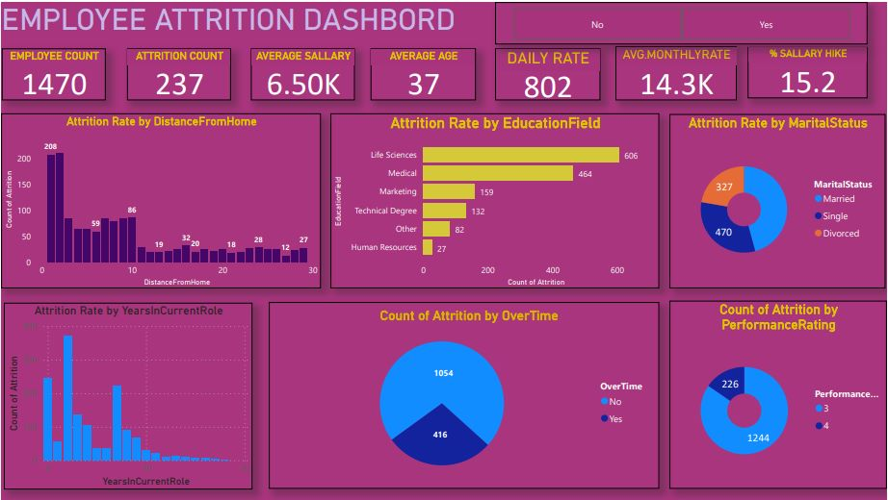
GRAPHICAL REPRESENTATION
EMPLOYEES ATTRITION DASHBOARD

Slide 23
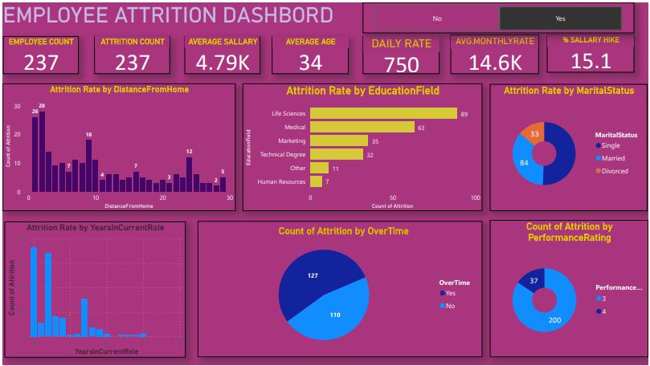
EMPLOYEES ATTRITION DASHBOARD OF EMPLOYEES WITH ATTRITION

Slide 24
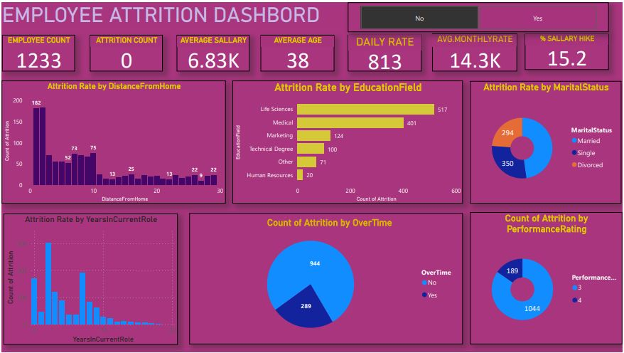
EMPLOYEES ATTRITION DASHBOARD OF EMPLOYEES WITHOUT ATTRITION

Slide 25
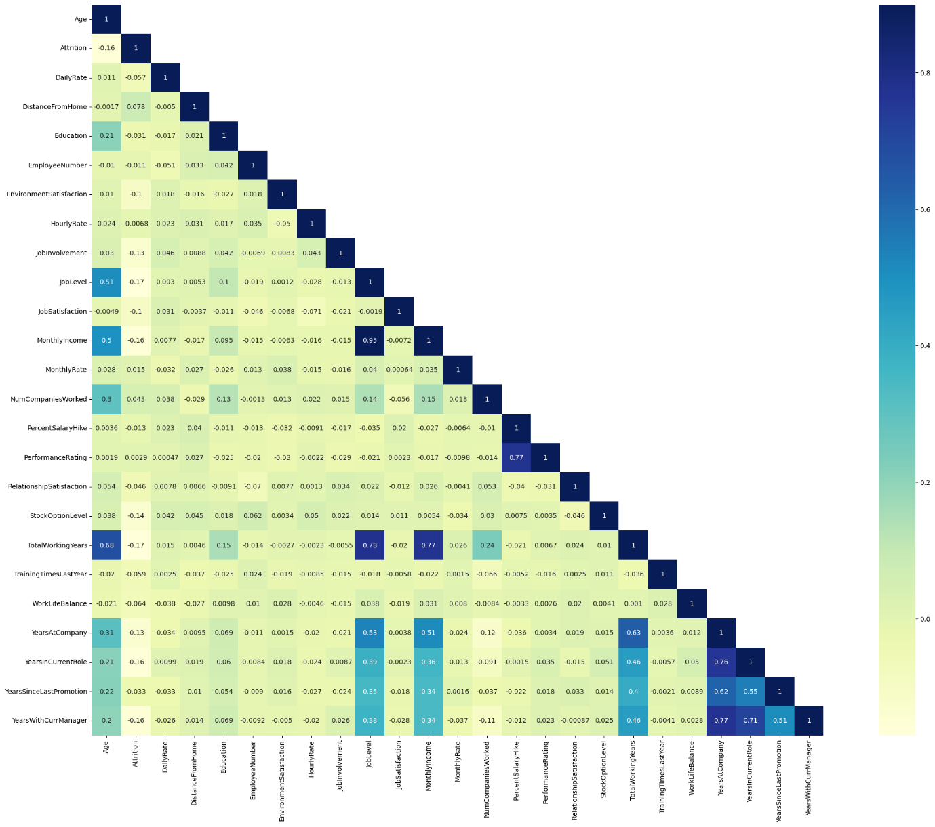
HEATMAP

Slide 26
EXPLORATORY ANALYSIS
Firstly we check whether there is any missing values or any duplicate values in the data.
After checking we found that there is no missing or duplicate value in the data.
There are total 1470 employees out of these 1233 employees belongs to class ‘No’ and 237 belongs to class ‘Yes’.
So this is imbalanced dataset.
To balance the dataset we are used oversampling method.
After over sampling minority class increases to class width of majority class i.e class width of both the class becomes 1233.

Slide 27
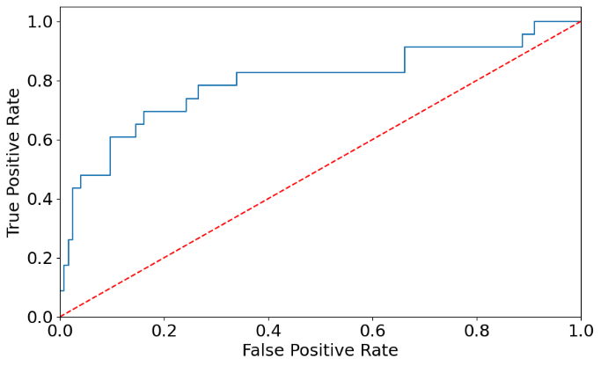
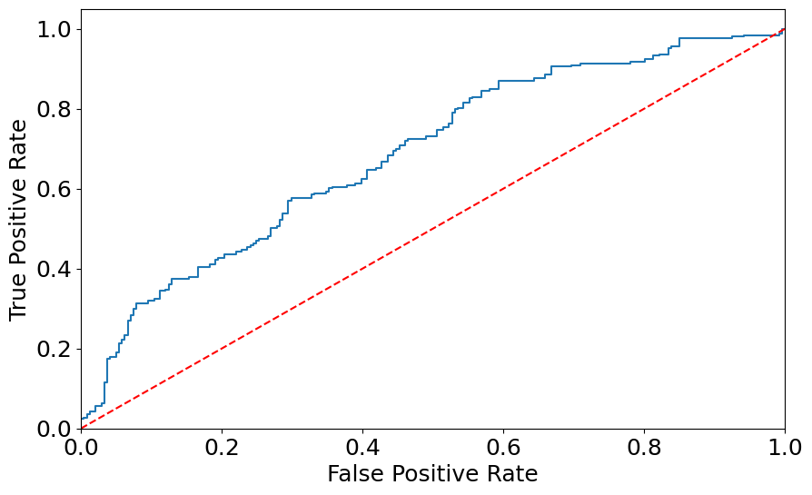
Logistic regression (ROC Curve)
Before oversampling
After oversampling
we apply logistic regression on imbalanced dataset but area under curve of logistic regression is 0.5.
so, we balance the data using random oversampling method and both the yes and no class becomes 1233.
After applying oversampling method area under curve of ROC becomes 0.61.

Slide 28
Logistic regression before oversampling
Confusion matrix
This confusion matrix shows that correctly classified attrition count is 255 ,incorrectly positive classified attrtion count is 39,correctly negative classified attrition count is 0,incorrectly negative classified attrition count is 0.
The accuracy of logistic model is 0.84 it implies that 84 % of times test results are correct.
 | 1 | 0
1 | 255 | 0
0 | 39 | 0
Accuracy | 0.84
Sensitivity | 0.8673
Specificity | 0
Precision | 0.80
F1 score | 0.91
Area under ROC curve | 0.50

Slide 29
Logistic regression after oversampling
Confusion matrix
 | 1 | 0
1 | 143 | 98
0 | 95 | 158
This confusion matrix shows that correctly classified attrition count is 143 ,incorrectly positive classified attrition count is 95,correctly negative classified attrition count is 98,incorrectly negative classified attrition count is 158.
Since, accuracy of logistic model is 0.6093 it implies that 60.93 % of times our test results are correct
Accuracy | 0.6093
Sensitivity | 0.61
Specificity | 0.9919
Precision | 0.0105
F1 score | 0.91
Area under ROC curve | 0.6089

Slide 30
2. Random Forest
 | 1 | 0
1 | 247 | 0
0 | 45 | 2
This confusion matrix shows that correctly classified attrition count is 247 ,incorrectly positive classified attrtion count is 45,correctly negative classified attrition count is 0,incorrectly negative classified attrition count is 2.
Accuracy of random forest model is 0.85 it implies that 85 % of times our test results are correct.
Accuracy | 0.85
Sensitivity | 1
Specificity | 0.042
Precision | 0.85
F1 score | 0.92

Slide 31
3.Support Vector Machine
Accuracy | 0.88
Sensitivity | 0.98
Specificity | 0
Precision | 0.88
F1 score | 0.93
Accuracy of support vector machine model is 0.88 it implies that 88 % of times our test results are correct.
4.Naïve bayes
Accuracy | 0.813
Sensitivity | 0.88
Specificity | 0.89
Precision | 0.89
F1 score | 0.88
Accuracy of naïve bayes classifier model is 0.813 it implies that 81.3 % of times our test results are correct.

Slide 32
5.K Nearest Neighbours
 | 1 | 0
1 | 232 | 15
0 | 39 | 8
This confusion matrix shows that correctly classified attrition count is 232 ,incorrectly positive classified attrition count is 39,correctly negative classified attrition count is 15,incorrectly negative classified attrition count is 8.
Accuracy of K-nearest neighbour model is 0.82 it implies that 82 % of times our test results are correct.
Accuracy | 0.82
Sensitivity | 0.9392
Specificity | 0.1702
Precision | 0.86
F1 score | 0.90

Slide 33
6. Artificial Neural Network
This confusion matrix shows that correctly classified attrition count is 207 ,incorrectly positive classified attrtion count is 32,correctly negative classified attrition count is 29,incorrectly negative classified attrition count is 26.
Accuracy of artificial neural network model is 0.79 it implies that 79 % of times our test results are correct.
 | 1 | 0
1 | 207 | 29
0 | 32 | 26
Accuracy | 0.79
Sensitivity | 0.88
Specificity | 0.4482
Precision | 0.87
F1 score | 0.87

Slide 34
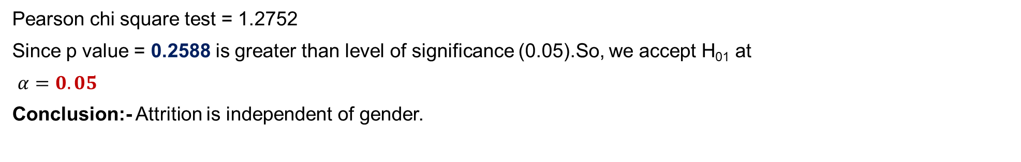
i. Chi square test of independence of attributes (Gender)
Hypothesis:
H₀₁: Attrition is independent of gender.
Vs
H₁₀: Attrition is dependent of gender.
Crosstab
 |  | Female | Male | Total
Gender | No | 501 | 732 | 1233
 | Yes | 87 | 150 | 237
Total |  | 588 | 882 | 1470
Pearson chi square test = 1.2752
Since p value = 0.2588 is greater than level of significance (0.05).So, we accept H₀₁ at
$α=0.05$
Conclusion:- Attrition is independent of gender.

Slide 35
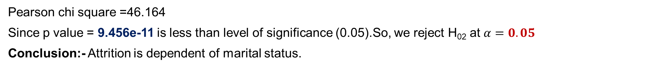
ii.Chi square test of independence of attributes (Marital status)
Hypothesis:
H₀₂: Attrition is independent of marital status.
Vs
H₂₀: Attrition is dependent of marital status.
Crosstab
Count
 |  | Divorced | Married | Unmarried | Total
Marital status | No | 294 | 589 | 350 | 1233
 | Yes | 33 | 84 | 120 | 237
Total |  | 327 | 673 | 470 | 1470
Pearson chi square =46.164
Since p value = 9.456e-11 is less than level of significance (0.05).So, we reject H₀₂ at $α=0.05$
Conclusion:- Attrition is dependent of marital status.

Slide 36
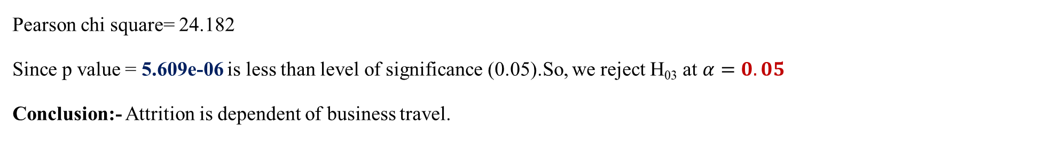
iii.Chi square test of independence of attributes (Business travel)
Hypothesis:
H₀₃: Attrition is independent of business travel.
Vs
H₃₀: Attrition is dependent of business travel .
Crosstab
Count
 |  | Non-travel | Travel-rarely | Travel-frequently | Total
Business travel | No | 138 | 208 | 887 | 1233
 | Yes | 12 | 69 | 156 | 237
Total |  | 150 | 277 | 1343 | 1470
Pearson chi square= 24.182
Since p value = 5.609e-06 is less than level of significance (0.05).So, we reject H₀₃ at $α=0.05$
Conclusion:- Attrition is dependent of business travel.

Slide 37
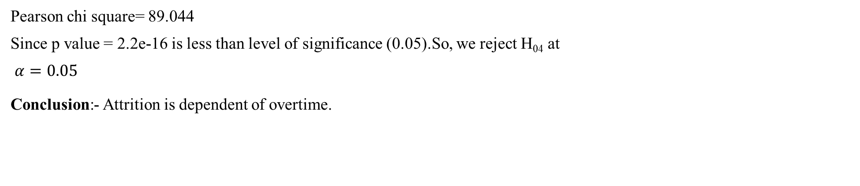
iv. Chi square test of independence of attributes (Overtime)
Hypothesis:
H₀₄: Attrition is independent on overtime.
Vs
H₄₀: Attrition is dependent on overtime.
Crosstab
Count
 |  | No | Yes | Total
Overtime | No | 944 | 289 | 1233
 | Yes | 110 | 127 | 237
Total |  | 1054 | 416 | 1470
Pearson chi square= 89.044
Since p value = 2.2e-16 is less than level of significance (0.05).So, we reject H₀₄ at
$α=0.05$
Conclusion:- Attrition is dependent of overtime.

Slide 38
Conclusions
SVM model is best fitted model for the dataset in hand.
Highly contributing factors which affects employees attrition are educational field, distance from home, years in current role, education.
Demographic factors like age, employee’s of age 25 to 35 having maximum rate of leaving the company Employees in the life science field having maximum rate of leaving the company.
Satisfaction level towards job is high in sales executive.
Factors such as low job satisfaction and low environment satisfaction that make employees dissatisfied.
Need of employees for searching new job is because of overtime.
Reasons for attrition among employee’s are medium education level , overtime, greater distance from home, low satisfaction level.
Employees whose education is medium having maximum rate of leaving the company.
The accuracy of SVM is better and this classifiers can be deployed to predict the employee’s are likely to leave the company.
Attrition is independent of gender and dependent of marital status, overtime and business travel.

Slide 39
REFERENCES
Books for Reference:
Statistical methods and use of R software
Prof. P. G. Dixit, Prof. V. R. Pawgi , Prof. P. S. Kapre
Fundamentals of mathematical statistics
S. C. Gupta
Descriptive Statistics
Prof. P. G. Dixit, Prof. Dr. Mrs. V. R. Prayag
Websites
www.google.com
www.youtube.com
www.tutorialspoint.com
https://towardsdatascience.com
www.scribbr.com
www.geeksforgeeks.org https://www.youtube.com/watch?v=xLkk6MUrvrw&ab_channel=5MinutesEngineering

Slide 40
https://www.youtube.com/watch?v=c7LrqSxjJQQ&ab_channel=LeilaGharani
https://www.youtube.com/watch?v=6cV3OwFrOkk&t=1145s&ab_channel=RishabhMishra
https://www.youtube.com/watch?v=bjLIA1vSqGs&ab_channel=LeanExcelSolutions
https://www.youtube.com/watch?v=Dc3MjUFsEa4&ab_channel=ExcelconceptuallearningwithM.ArifAslam
Other references
Research articles
An investigation into the effect of knowledge management on employee retention in the telecom sector
A study of employees attrition among executives at BGR energy systems ltd, Chennai
Employee attrition using predictive techniques
Employees Attrition Prediction Using Deep Neural Networks
Explaining and predicting employee’s attrition: a machine learning approach
From big data to deep support people analytics for employee attrition prediction
Predictive employees attrition using machine learning approches

Slide 41
THANK YOU!

